Slide 1
“Why get involved in NARPM®” (Sub-Titled) “How I grew into a NARPM® leader”
Vickie Gaskill, MPM®, RMP®, CPM®, ARM®
Bell-Anderson & Assoc., LLC, AMO®, CRMC®
www.bell-anderson.net
vgaskill@bell-anderson.net

Slide 2
Objectives
Why Involvement in NARPM®
Associations need volunteers
Competencies for Leadership
Leadership as Course of Conduct
Past Presidents Report

Slide 3
What does involvement mean?
Participation
Immersion
Association
Taking Part
Connection
Contribution

Slide 4
Why NARPM®? (straight from website)
The Success
The Education
The Classes
The Designations
Information Sharing

Slide 5
Why NARPM®? (Cont.)
The Networking
The Ideas
The Friendships
Member Support
Strategic Relationships
Your Growth

Slide 6
Professional Designations
RMP® - Residential Management Professional
MPM® - Master Property Manager
CRMC® - Certified Residential Management Company (Companies only)
CSS® - Certified Support Specialist
CMC – Certified Maintenance Coordinator
CRMB – Certified Residential Management Bookkeeper

Slide 7
Qualifications
Application
Member in Good Standing
Letters of Recommendation
Experience
Education
Ethics
Attendance at National Convention or Broker/Owner Retreat
Elective Points – Volunteering on a Local, State or National level

Slide 8
Volunteering
Skills
Experiences
Inspiration
Growth in Leadership Roles

Slide 9
Develop Your Competencies
Develop as individuals first
Leave your ego at the door
Learn from adversity and problems
Align your energy with others
Develop the capacity to adapt and change
Don’t be afraid to be vulnerable

Slide 10
From There Comes Leadership:
Inspire
Genuine and believe in serving others
Coach
Trainer of future leaders (#1)
Teach, Tutor, and Mentor
Empower
Delegate
Let others make decisions

Slide 11
Growing into a NARPM® Leader
Discovered the need and stepped in to help – Sylvia Hill, MPM®, RMP®, 2007 NAPRM® President
When asked, applied – Tony Drost, MPM®, RMP®, 2011 NAPRM® President
Developed friendships and found my family – Susan Gordon, MPM®, RMP®, 1988-1990 NAPRM® President
Involvement was the best thing I could do for me and my business – Andy Probst, MPM®, RMP®, 2015 NARPM® President

Slide 12
Growing (cont.)
Interaction with fellow Property Managers – Andrea Caldwell, MPM®, RMP®, 2004 NARPM® President
I was voluntold. It was to give back - Bart Sturzl, MPM®, RMP®, 2016 NARPM® President
Something in me I didn’t know I had - Ray Scarabosio, MPM®, RMP®, 1999-2000 NARPM® President
Natural progression to move from local to the national level - Rose Thomas, MPM®, RMP®, 2006 NARPM® President

Slide 13
Growing (cont.)
Additional opportunities like book publishing – Melissa Prandi, MPM®, RMP®, 2000-2001 NARPM® President
Taught me to listen, adopt, adjust and apply - Mark Kreditor, MPM®, RMP®, 1997-1998 NARPM® President
Encouraged by some wonderful early leaders - Kit Garren, MPM®, RMP®, 1994-1995 NARPM® President
Had to (Kit wouldn’t) - Dave Holt, MPM®, RMP®, 1993-1994 NARPM® President

Slide 14
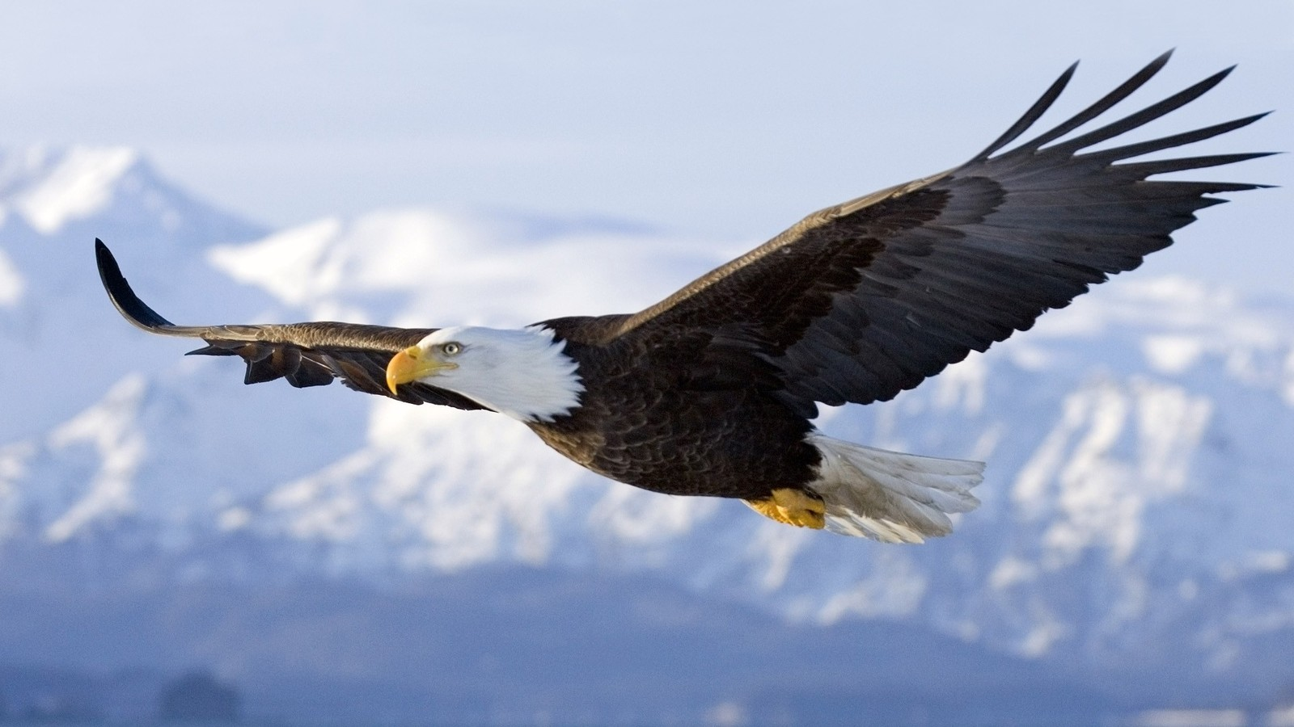
My Story – “Dare to Soar”

Slide 15
“If you are giving, loving, serving, helping, encouraging, and adding value to others, then you’re living a life that counts”
Dr. John Maxwell

